Slide 1

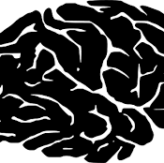
Brain Tumor Detection
DS677: Deep Learning
Section: 002
Department: Data Science
Team Members:
KRUPA LAKHANI
BHAVYA AMISH SHAH
DEEP PATEL
Notes:
Format/position the textbox containing the class name

Slide 2
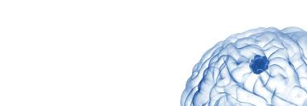
Agenda
1.Introduction
2.Motivation
3. Related Works
4.Problem Statement
5.Approach
6.Data Overview
7. Data PreProcessing
8.Data Visualization
9. Model Training Process
9.Model Evaluations
10.Key Findings
11.Model Prediction Result
12.Conclusion & Future Work
13.References
A brain tumor is an abnormal growth of cells in the brain. It can disrupt brain function and cause various symptoms depending on its location and size.

Slide 3
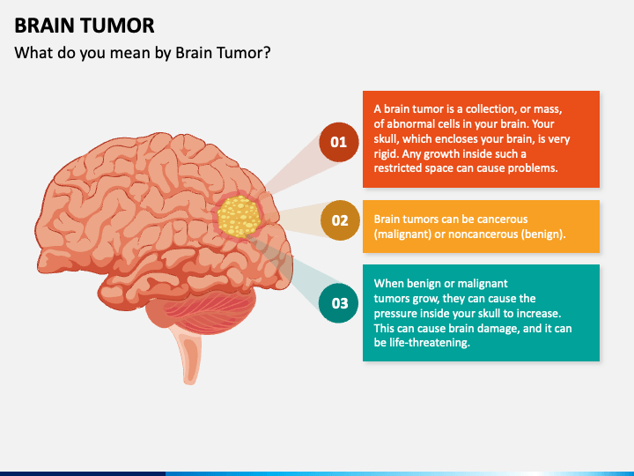
Introduction
What is Brain Tumor
Brain Tumors are classified as: Benign Tumor, Malignant Tumor, Pituitary Tumor, etc.
Proper treatment, planning, and accurate diagnostics should be implemented to improve the life expectancy of the patients.
The best technique to detect brain tumors is Magnetic Resonance Imaging (MRI). A huge amount of image data is generated through the scans.

Slide 4
Motivation
01 | Advancing Healthcare
 | Brain tumors account for 85 to 90 percent of all primary Central Nervous System(CNS) tumors. Every year, around 11,700 people are diagnosed with a brain tumor. The 5-year survival rate for people with a cancerous brain or CNS tumor is approximately 34 percent for men and 36 percent for women. By leveraging advanced technologies like deep learning and medical imaging, such a project aims to enhance the accuracy and efficiency of tumor identification, leading to timely medical intervention and improved patient outcomes. Moreover, it addresses the pressing need for innovative solutions in healthcare, fostering advancements in medical research and technology with the ultimate goal of improving public health.

Slide 5
Related Works
Utilized transfer learning techniques with models such as AlexNet, GoogLeNet, ResNet50, ResNet 101, and SqueezeNet for classifying brain tumors into benign or malignant. AlexNet achieved the highest accuracy at 99.04%. Experimented with Adam, RMSProp, and SGDM optimizers, noting their impact on accuracy and training time. Implemented data augmentation due to limited dataset size. [1]
Employed ResNet50 achieving an F1-score of 92.34%. Introduced a novel data augmentation method using Principal Component Analysis (PCA) and compared it with traditional CNN. Evaluated 12 augmentation techniques including PCA, cropping, flipping, rotation, resizing, etc., with PCA showing superior results. [2]
Utilized pretrained models including Xception, NasNet Large, DenseNet121, and Inception ResNet V2. Xception achieved the highest accuracy at 99.67%. Explored different optimizers such as Adam, SGD, and RMSProp, with Adam yielding the best results. Mitigated overfitting with dropout and data augmentation. Set hyperparameters: epochs - 50, batch size - 64, image size - 224x224, activation - softmax, dropout rate - 0.2, regularization - L2. [3]
Notes:
Fine-Tuned Model:

Slide 6
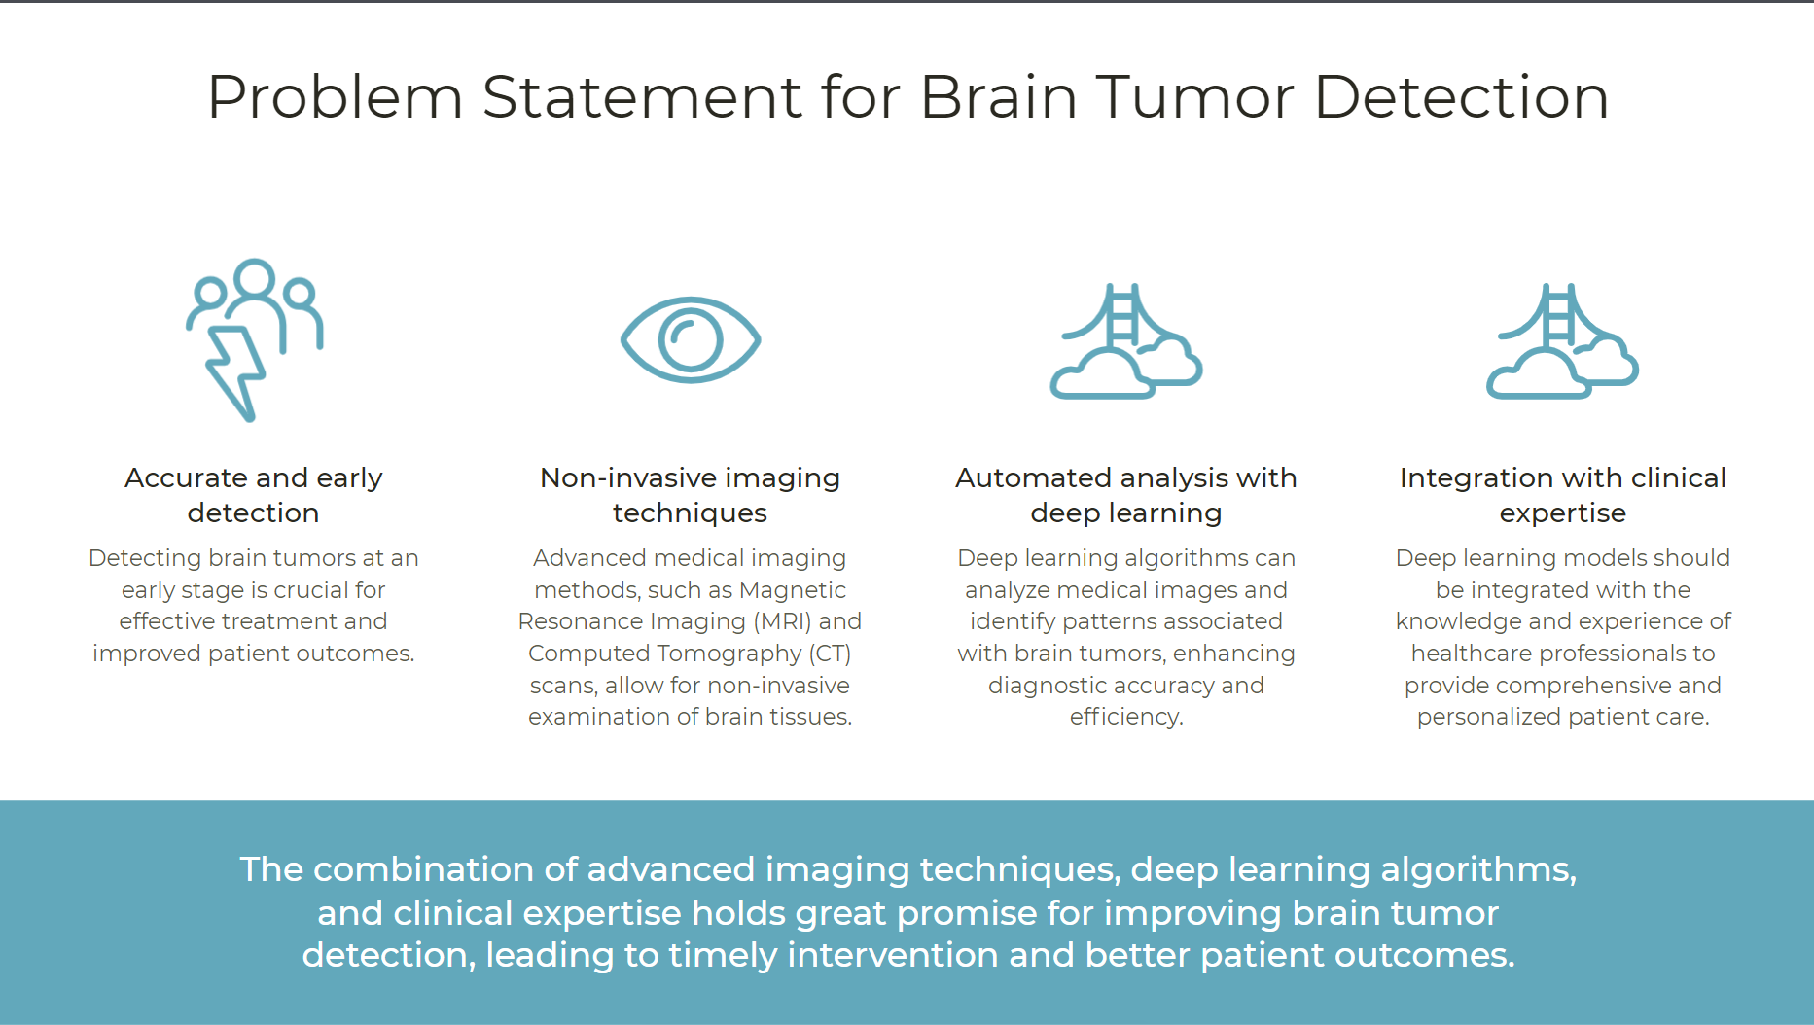

Slide 7
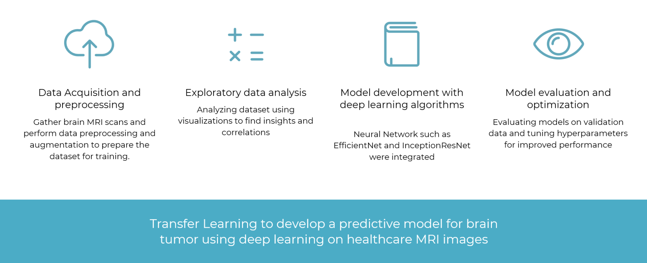
Approach

Slide 8
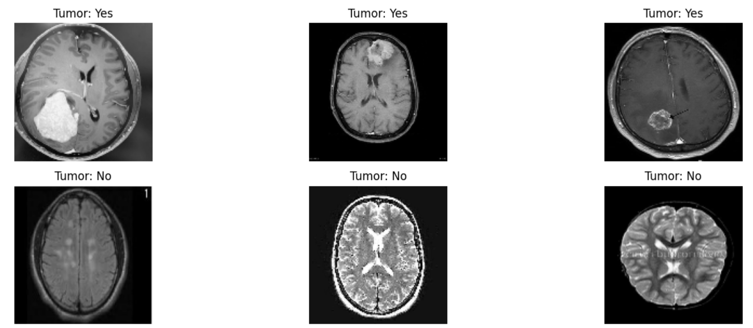
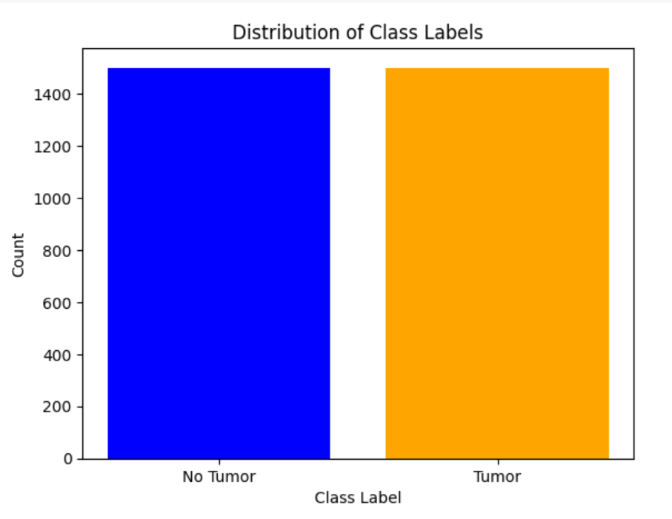
Data Overview
Content
Diversity
Binary Classes
The dataset comprises three folders: "yes," "no," and "pred," collectively containing 3060 Brain MRI Images. "Yes" folder contains 1500 images depicting tumorous brains, while the "no" folder contains 1500 images showing non-tumorous brains.
The dataset exhibits diversity in brain MRI images, encompassing various angles, resolutions, and conditions to provide a comprehensive representation of tumorous and non-tumorous brain scans.
The dataset is divided into two primary classes: "tumorous" and "non-tumorous," representing the presence or absence of brain tumors in MRI images.

Slide 9
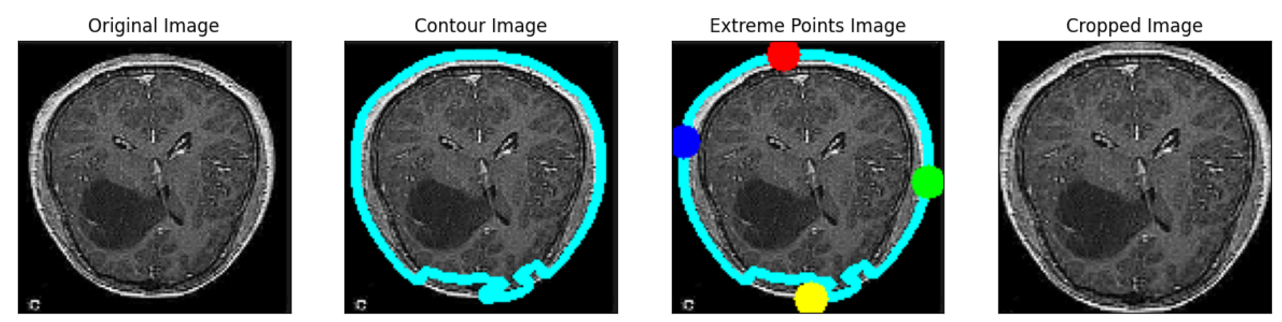
Data PreProcessing
In data preprocessing, the MRI images were cropped to isolate the brain region, removing extraneous background information. This step helps focus the model's attention on relevant features for accurate brain tumor detection.

Slide 10
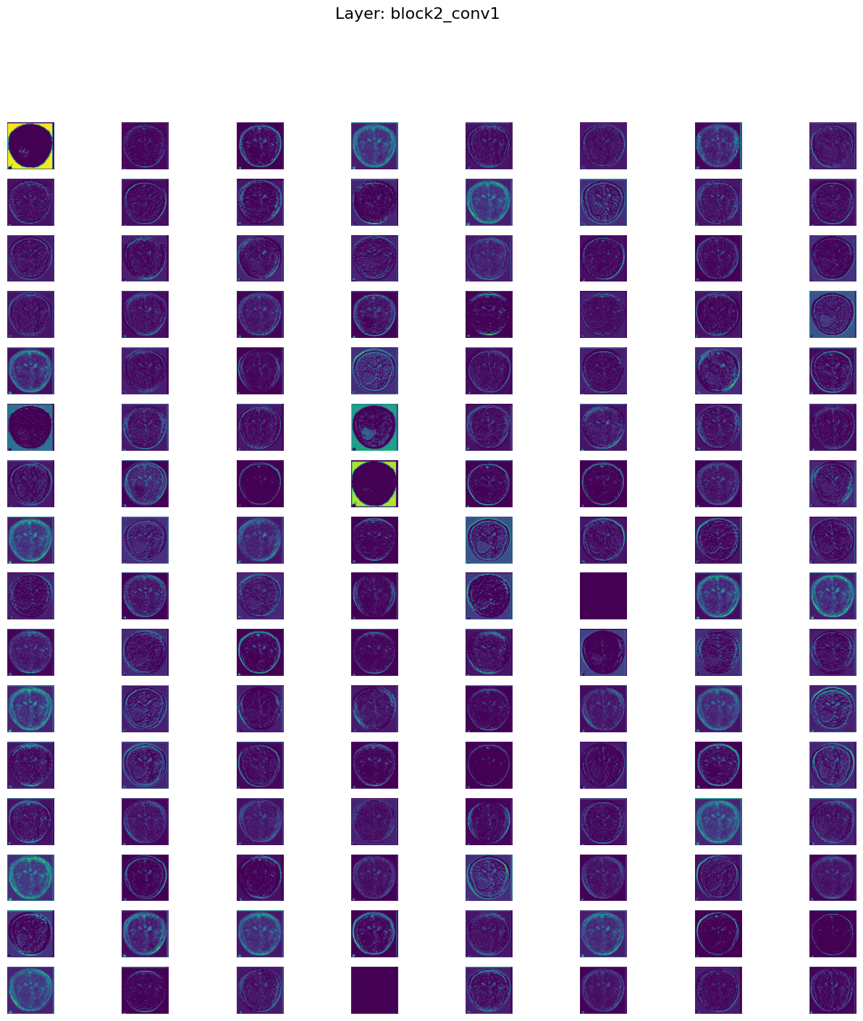
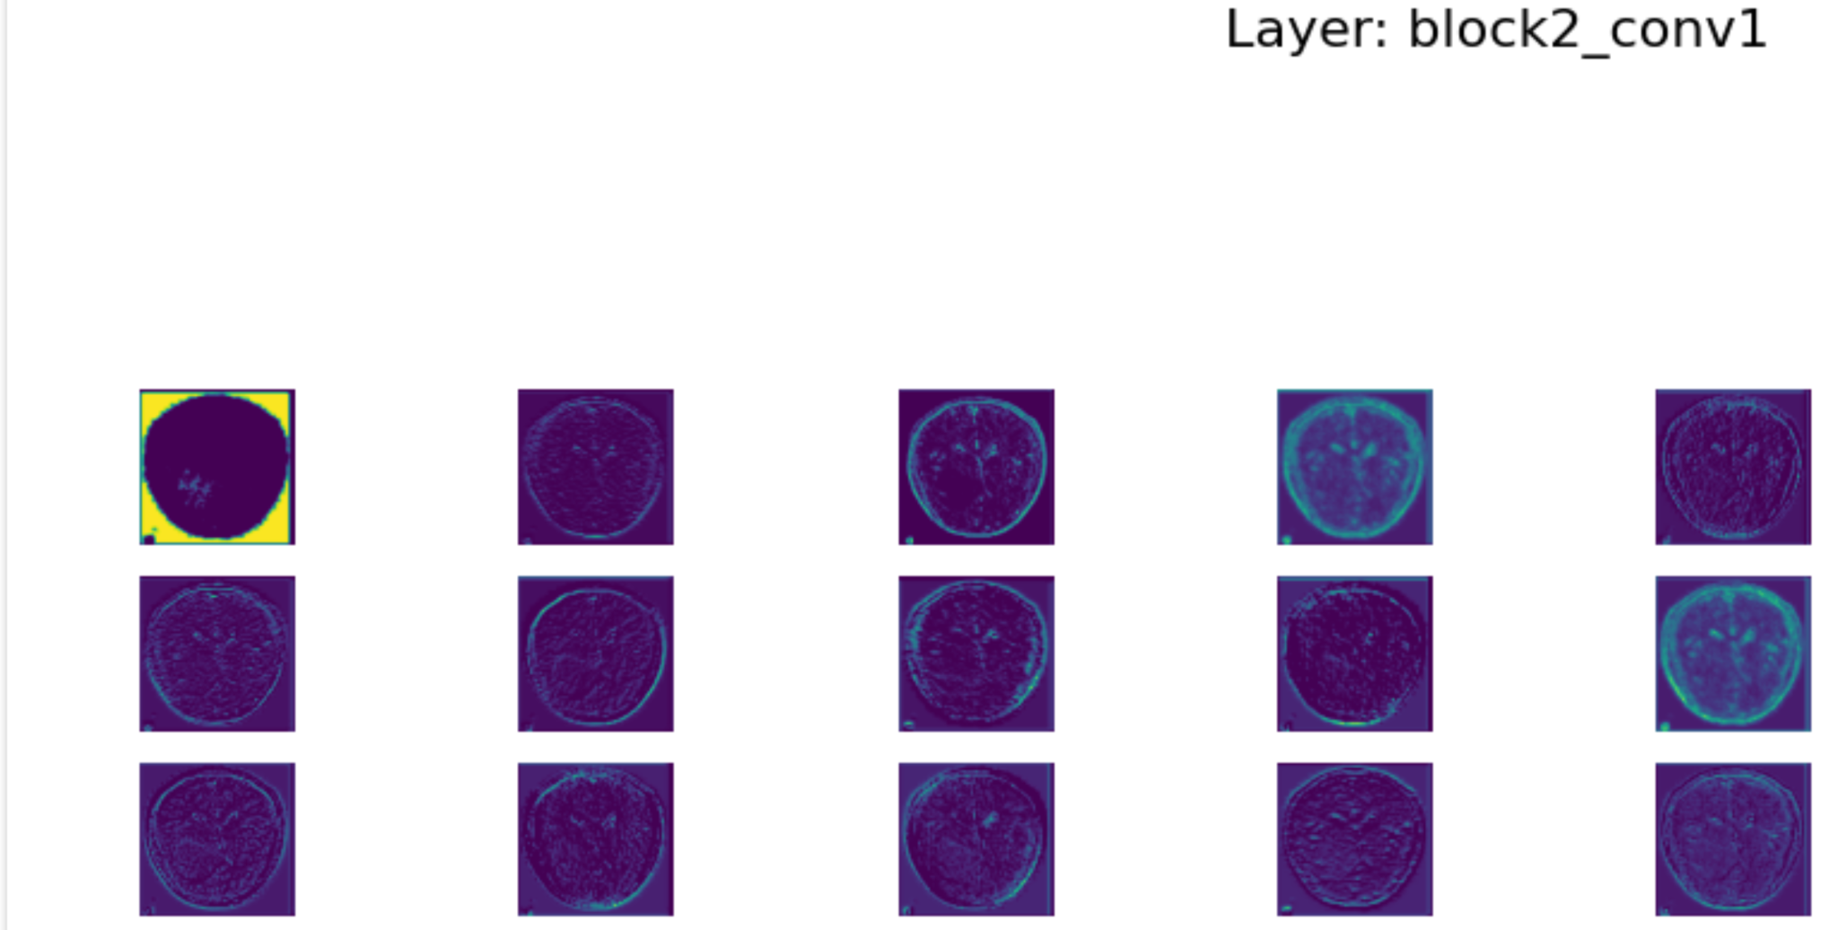
Data Visualization

Slide 11
Model Training Process
01
02
03
Data Preprocessing
Model Definition
Model Training
Before training the model, the MRI images are preprocessed by resizing, normalizing, and cropping to extract the relevant brain region.
In this step, the architecture of the InceptionResNetV2, EfficientNet, ResNet models are defined, specifying the layers, parameters, and connections to be used for feature extraction & classification.
The learned model is transferred on the preprocessed MRI image dataset using techniques like Adam optimization to minimize the loss function & improve accuracy.
04
Model Evaluation
Once trained, the model's performance is evaluated on a separate validation dataset to assess its accuracy, precision, recall, and F1 score, providing insights into its effectiveness in tumor detection
08
07
06
Model Saving
To optimize performance further, hyperparameters such as learning rate, batch size, and dropout rates are fine-tuned through iterative experimentation to achieve the best possible results.
Comparing models
Model Tuning
All the models were compared , out of which Optimized InceptionResnet - V2 is our best model.
After training and tuning, the final trained model parameters are saved to disk, allowing for future deployment and inference on new MRI images.
Notes:
Data preprocessing: missing values, categorical to numeric, is irrelevant here

Slide 12
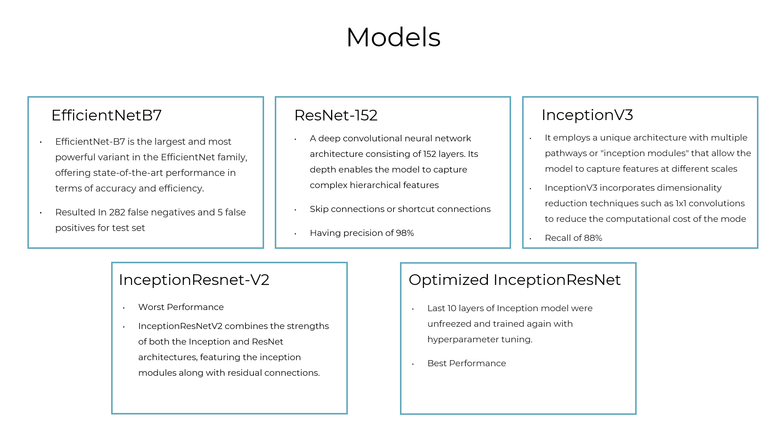

Slide 13
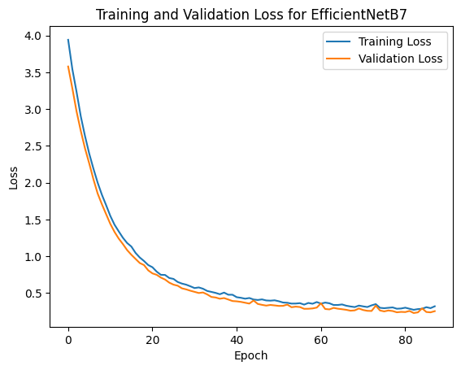
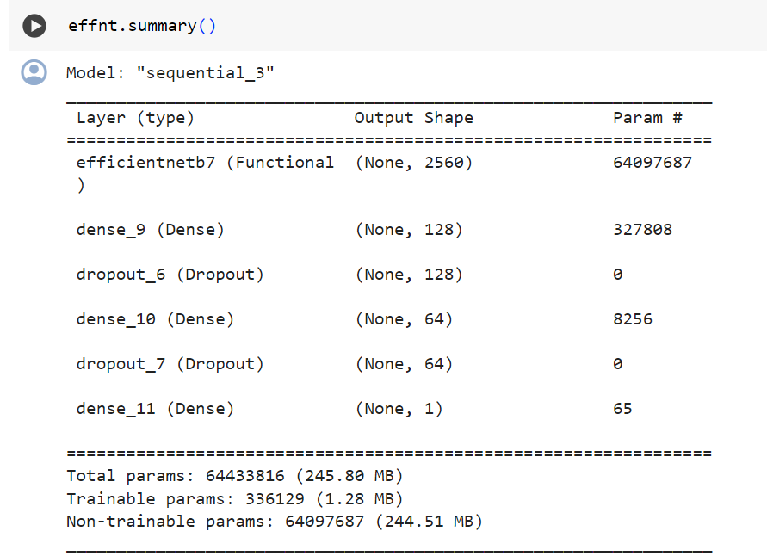
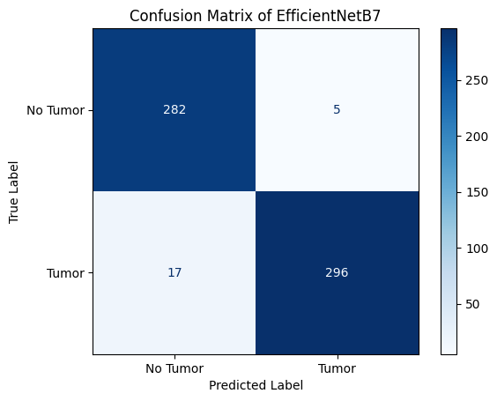
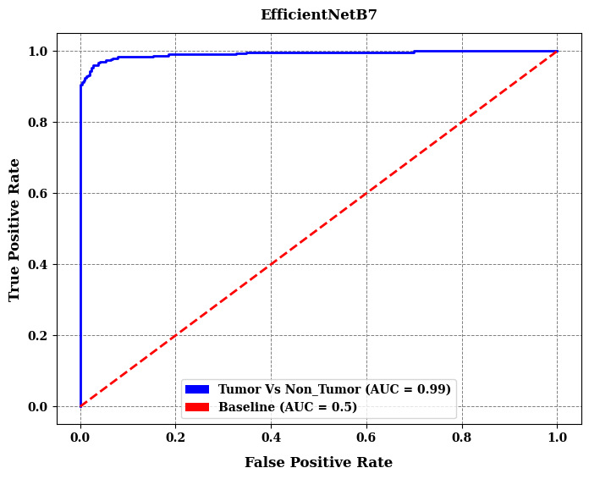
EfficientNet - B7
Notes:
... the screenshot of the model architecture is blurred

Slide 14
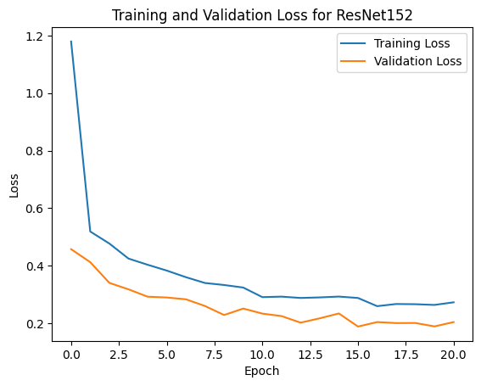
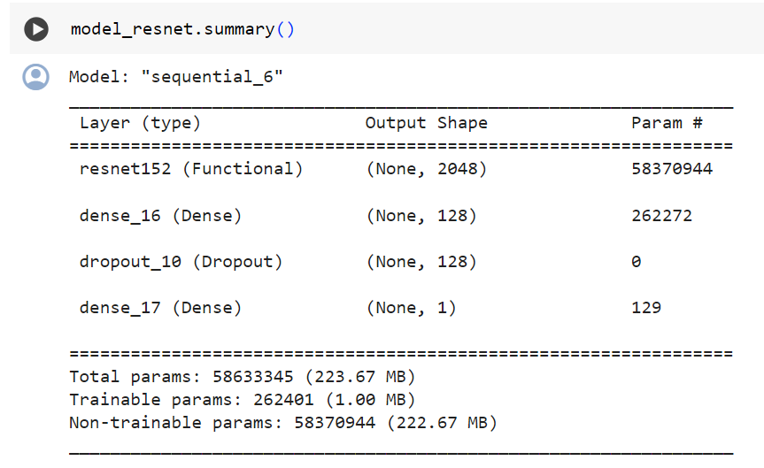
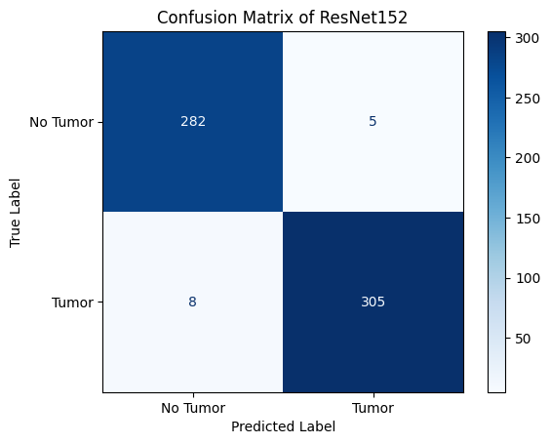
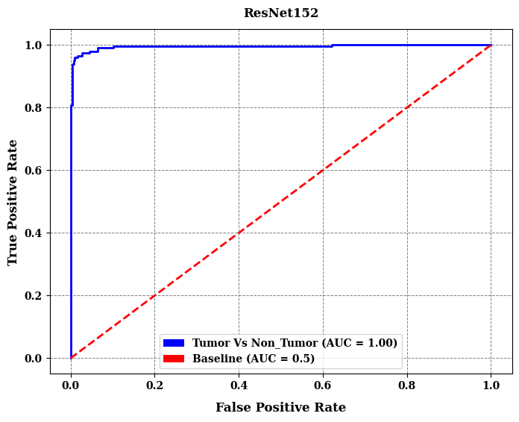
ResNet - 152
Notes:
... ... the screenshot of the model architecture is blurred

Slide 15
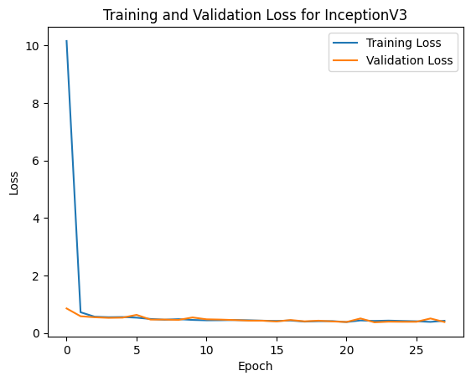
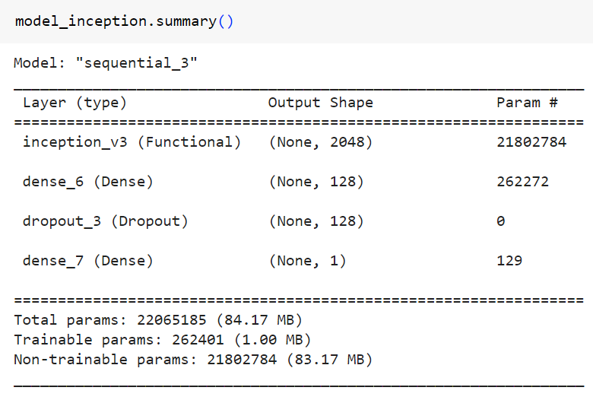
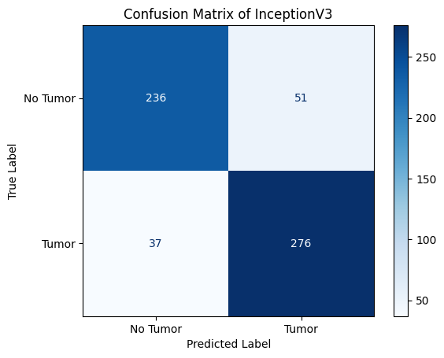
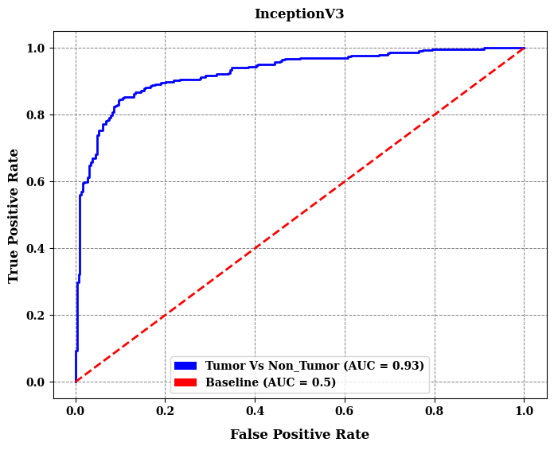
Inception - V3
Notes:
...

Slide 16
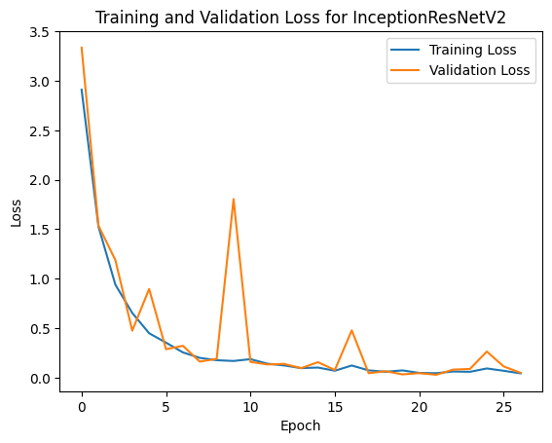
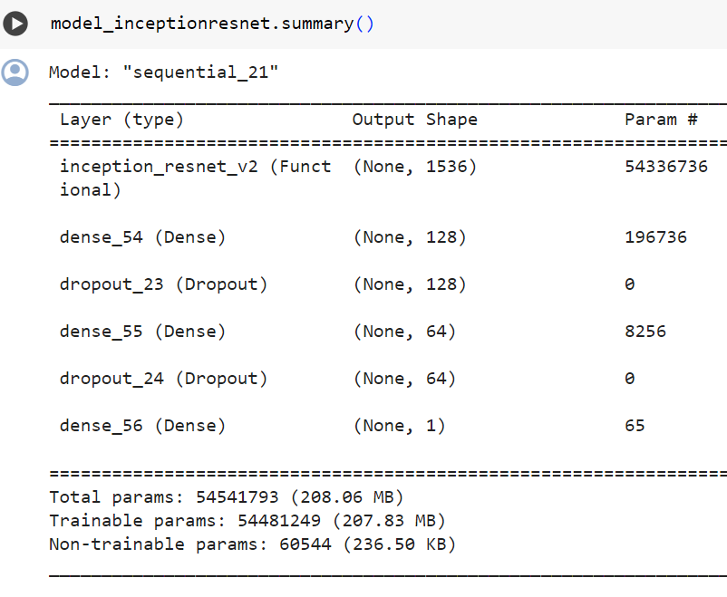

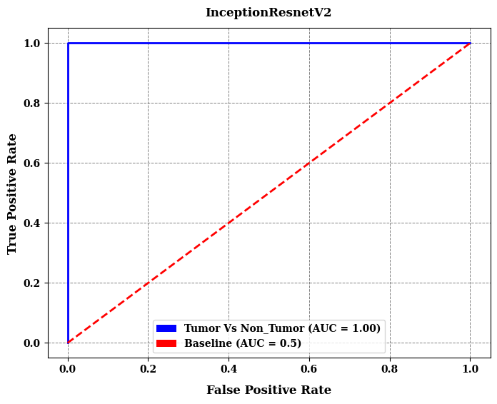
InceptionResNet - V2
Notes:
...

Slide 17
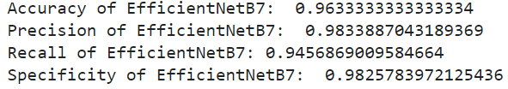
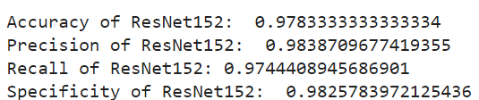
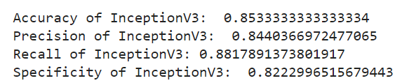
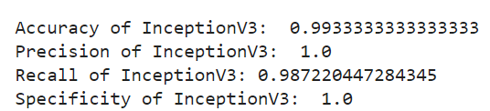
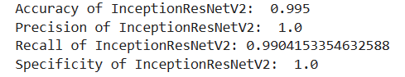
Model Predictions
EfficientNet - B7
First Prediction
Model Predictions
ResNet - 152
Inception - V3
Optimized InceptionResNet - V2
Notes:
Model Predictions:
1. Prediction on New Data:
Demonstration of how the trained model makes predictions on new or unseen data.
Sample input tweets or text snippets used for prediction.
2. Visualizing Predictions:
Displaying a comparison of the model's predictions against the true labels.
Highlighting correct predictions and instances where the model may have misclassified.
3. Confidence Scores:
Discussing the confidence scores assigned by the model to its predictions.
Analyzing cases where the model is more or less confident in its predictions.
4. Performance Metrics on Test Data:
Calculation of performance metrics (e.g., accuracy, precision, recall, F1-score) on a test dataset.
Discussion on how well the model generalizes to new data.
5. Example Predictions:
Providing examples of tweets or text snippets along with the model's predictions and true labels.
Discussing interesting or challenging cases where the model performed exceptionally well or struggled.
6. Real-World Application:
Exploring potential real-world applications of the model predictions.
Discussing how the sentiment analysis results can be utilized for decision-making or insights.
7. Feedback Loop and Model Refinement:
Addressing the possibility of a feedback loop where model predictions inform further improvements.
Discussing any plans for model refinement based on observed performance on new data.
Key Takeaways:
Model predictions extend beyond the training and validation datasets to new, unseen data.
Visualizing predictions provides insights into model behavior and areas for improvement.
Confidence scores aid in understanding the model's certainty in its predictions.
Real-world applications highlight the practical significance of sentiment analysis results.
The feedback loop enables continuous improvement and refinement of the model.

Slide 18
Future Works:
Future work includes refining the model to identify the specific location of brain tumors within MRI images, enabling precise localization for targeted treatment strategies.
Additionally, efforts will be directed towards enhancing the model's classification capabilities to enabling it to accurately differentiate between malignant tumors like pituitary, glioma, and meningioma, facilitating more accurate prognoses and treatment planning.
Expanding the model's application to include CT scans is a key objective, allowing for a broader range of imaging modalities to be utilized for brain tumor detection and characterization.
Exploration of alternative neural network architectures such as DenseNet, MobileNet, and Xception presents exciting opportunities to further improve the model's performance and robustness, potentially uncovering novel insights in brain tumor detection and analysis.
Notes:
LSTM is a specialized type of recurrent neural network (RNN). Unlike traditional RNNs, LSTMs are adept at handling long-term dependencies in sequential data, mitigating the vanishing gradient issue. They feature memory cells that store information, with input and forget gates regulating data flow. LSTMs excel in tasks requiring an understanding of context and relationships within sequences, making them valuable for natural language processing, speech recognition, and time-series analysis

Slide 19
Conclusion
InceptionResNet - V2 Mastery
01
InceptionResNetV2 stands out as the most effective model in our study, achieving an outstanding accuracy of 99.50%
Combatting Overfitting
02
Implementation of data augmentation techniques, early stopping strategies, and dropout mechanisms effectively prevented overfitting in our model.
Enhanced Generalization
03
By addressing overfitting, our model demonstrates robust performance and enhanced generalization capability across diverse datasets
Future Prospects
04
These findings highlight the potential of advanced neural network architectures like InceptionResNetV2 to revolutionize brain tumor detection
Notes:
Bias in Training Data:
The effectiveness of the sentiment analysis model heavily relies on the quality and representativeness of the training data. If the training data contains biases or does not adequately cover the diversity of sentiments, the model may exhibit biased predictions.
Resource Intensiveness of LSTM:
or when dealing with large volumes of data.
Overfitting to Training Data:
LSTM models, if overly complex or trained for too many epochs, may become too specialized in the training data. This overfitting can lead to the model memorizing the training examples rather than learning general patterns
:
LSTMs can be sensitive to noise and outliers in the training data. If the training set contains noisy or outlier examples, the model may inadvertently learn from these atypical instances. This can result in a model that overfits to unusual patterns

Slide 20
References
A. Anaya-Isaza and L. Mera-Jiménez, "Data Augmentation and Transfer Learning for Brain Tumor Detection in Magnetic Resonance Imaging," in IEEE Access, vol. 10, pp. 23217-23233, 2022, doi: 10.1109/ACCESS.2022.3154061.
keywords: {Tumors;Task analysis;Artificial intelligence;Deep learning;Cancer;Residual neural networks;Principal component analysis;Artificial intelligence;biomedical imaging;cancer;machine learning;medical diagnostic imaging},
S. Asif, W. Yi, Q. U. Ain, J. Hou, T. Yi and J. Si, "Improving Effectiveness of Different Deep Transfer Learning-Based Models for Detecting Brain Tumors From MR Images," in IEEE Access, vol. 10, pp. 34716-34730, 2022, doi: 10.1109/ACCESS.2022.3153306.keywords: {Tumors;Brain modeling;Magnetic resonance imaging;Feature extraction;Transfer learning;Solid modeling;Deep learning;Brain tumor classification;transfer learning;deep learning;magnetic resonance imaging;convolutional neural network},
Mehrotra, R., Ansari, M., Agrawal, R., & Anand, R. (2020). A Transfer Learning approach for AI-based classification of brain tumors. Machine Learning With Applications, 2, 100003. https://doi.org/10.1016/j.mlwa.2020.100003
G. Gayathri and S. Sindhu, "Efficientnet for Brain Tumor Detection from MRI," 2022 Third International Conference on Intelligent Computing Instrumentation and Control Technologies (ICICICT), Kannur, India, 2022, pp. 322-326, doi: 10.1109/ICICICT54557.2022.9917728. keywords: {Training;Image segmentation;Thresholding (Imaging);Convolution;Magnetic resonance imaging;Brain modeling;Biological neural networks;Tumor Segmentation;Data Augmentation;Tumor Detection;EfficientNet},
Ahmad, Saif, and Pallab K. Choudhury. "On the performance of deep transfer learning networks for brain tumor detection using MR images." IEEE Access 10 (2022). Keywords: {Tumors, Brain modeling, Computational modeling, Feature extraction, Support vector machines, Transfer learning, Magnetic resonance imaging}
Notes:
Why Not Naive Bayes:
Naive Bayes' Oversimplified Model Fails to Capture Context and Sequential Dynamics in Text, Limiting its Accuracy and Versatility in Sentiment Analysis.
LSTM's Sequential Understanding Trumps Naive Bayes' Word Independence:
LSTM effectively captures sequential dependencies in text, providing a contextual understanding that outperforms Naive Bayes' simplistic assumption of word independence.
LSTM Excels in Analyzing Complex Sentence Structures, a Weakness for Naive Bayes:
LSTM's strength in processing intricate sentence structures makes it superior to Naive Bayes, which struggles with the complexity of sentiments expressed in longer, convoluted texts.
Adaptability to Dynamic Vocabulary: LSTM Navigates Unseen Terms, While Naive Bayes Stumbles:
LSTM's adaptability to diverse and evolving vocabularies on platforms like Twitter surpasses Naive Bayes, which is hindered by a fixed vocabulary and may struggle with out-of-vocabulary terms.
Deep Learning Feature Extraction vs. Naive Bayes' Manual Engineering:
LSTM's deep learning approach automatically extracts relevant features from raw text, reducing the need for manual feature engineering—unlike Naive Bayes, which heavily relies on predefined features.
Robustness in Handling Imbalanced Datasets: LSTM Prevails Over Naive Bayes' Sensitivity:
LSTM exhibits robustness in handling imbalanced datasets, a challenge for Naive Bayes, which can lead to biased predictions, especially when sentiments are not evenly distributed.
Domain Adaptability: LSTM Transcends, While Naive Bayes Stumbles Across Domains:
LSTM's adaptability to different domains and languages makes it a versatile choice for sentiment analysis tasks, contrasting with Naive Bayes' limitations when faced with unfamiliar contexts.

Slide 21
THANK YOU !!!!
WE ARE OPEN FOR QUESTIONS NOW

